Slide 1
Arrest data tells a story
Insights from arrest data in Toronto

Slide 2
Background information:
-This data was from Kaggle titled “Marijuana Arrests in Toronto: Race, Release, and Policing (1997-2002).
-This was originally made public in the Toronto Star newspaper and is within public domain. Kaggle received it from Michael Friendly at York University.
-The set examines 5226 arrestees with variables such as age, year arrested, number of previous checks in police systems, race, sex, whether each was a citizen, whether each was employed, and whether each was released.
Note: I have concerns about using this data to examine race without having more information. According to metadata, the category labeled “colour” is described as “the arrestee’s race.” However, it is unclear how this distinction was determined and whether it reflects intricacies of race. I will use the data as I have it to discover what information it might tell us, however, I ask that we keep awareness of possible inaccuracy or oversimplification on the topic of race. Similar concerns may apply to the category of sex, as well, though as it is labelled sex rather than gender, we might assume that this distinction refers to biological sex or sex assigned at birth rather than gender.

Slide 3
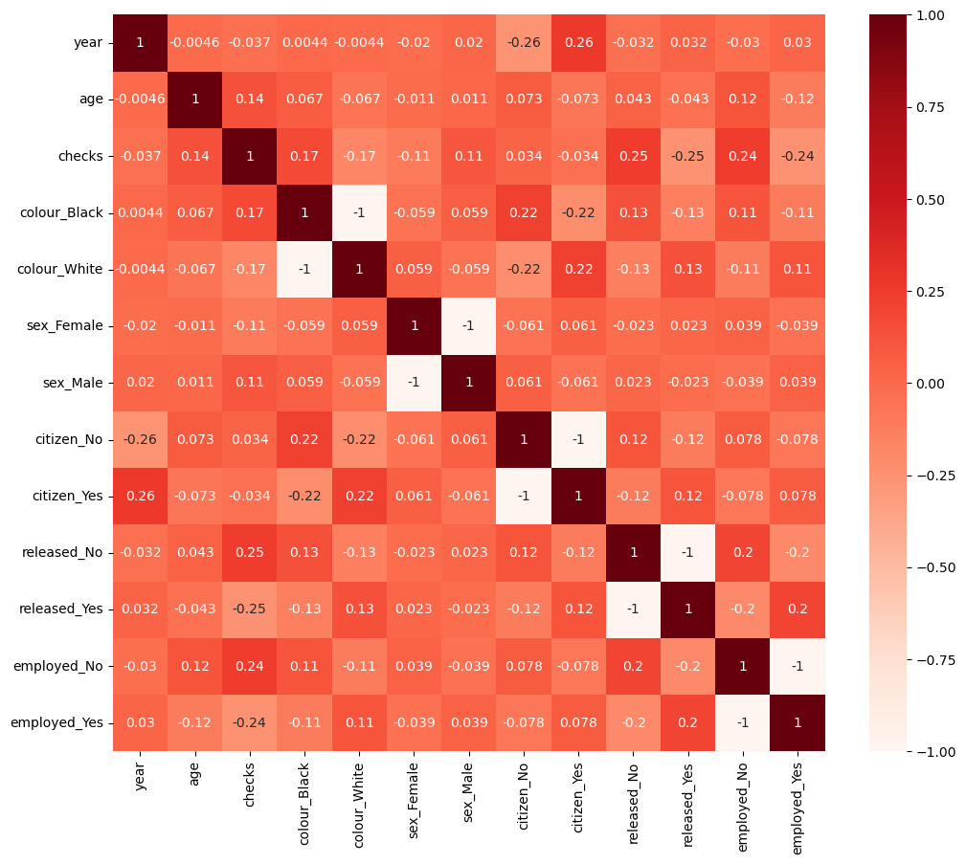
Looking at correlations between each variable, there are some hints about what we might learn more about, but nothing clear enough to make conclusions about yet.
Let’s continue forward to see what we can find out by looking at some individual variables and combinations.

Slide 4
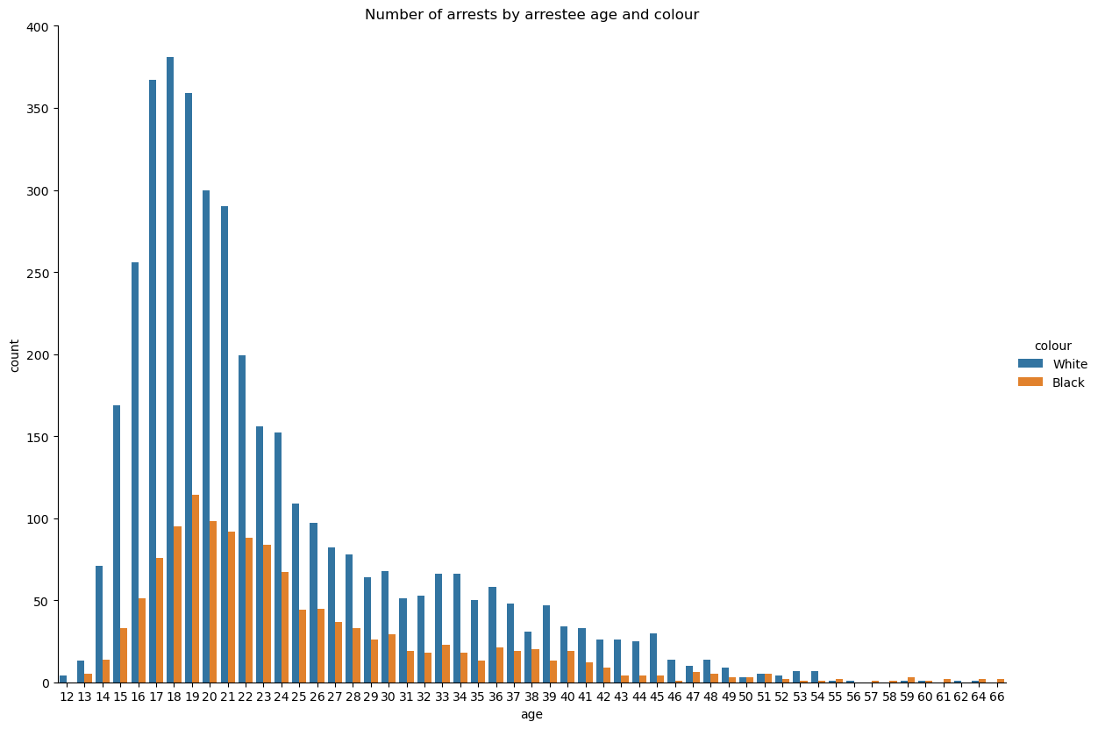
* Age when arrested appears similar regardless of race *

Slide 5
Group | Average checks | Average age | Proportion released
White | 1.485018 | 23.526409 | 0.858050
Black | 2.099379 | 24.825311 | 0.741460
Female | 1.092551 | 23.532731 | 0.857788
Male | 1.686807 | 23.875601 | 0.826678
Employed | 1.441742 | 23.341279 | 0.867915
Unemployed | 2.354260 | 25.709417 | 0.686996
Non-citizen | 1.762646 | 25.299611 | 0.725032
Citizen | 1.614590 | 23.595062 | 0.847363
* Number of checks appear significantly higher for black and unemployed arrestees and lower for female arrestees.
* Proportion of those released appears significantly lower for black, non-citizen, and especially unemployed arrestees.
* Other groups appear similar for all categories

Slide 6
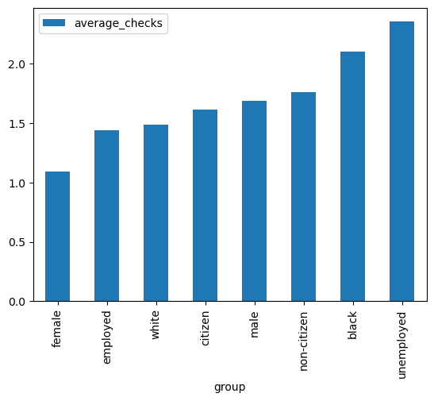
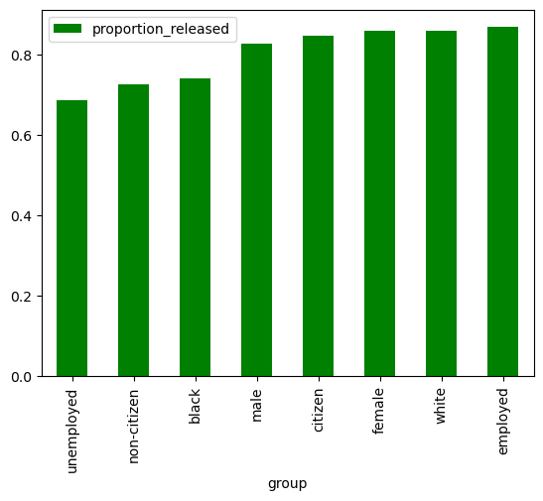
Visual comparison:

Slide 7
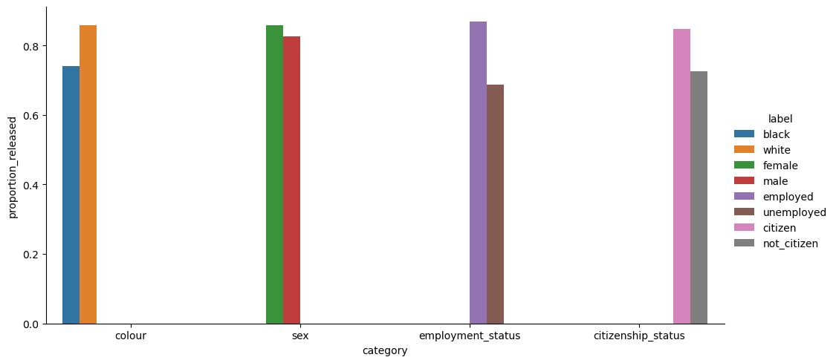

Slide 8
Conclusions:
Within this set of arrestees, some groups received different treatment than others, both in the number of times they are in police systems and in whether or not they are released:
Female arrestees are released at a higher proportion than male arrestees.
Black arrestees and unemployed arrestees have higher numbers of checks and are released at lower rates than white and employees arrestees.
Non-citizens are also released at lower rates than citizens.
In Toronto, between 1997 and 2002, those who were female fared better when arrested for “small amounts of marijuana” than those who were male, black, unemployed, and/or non-citizens.
* Note that we cannot make broader conclusions based on this single dataset.

